Slide 1
Software engineering (Undergraduate)
Chapter 8 data flow testing
Course Name software quality and testing
CSC 4133
(Undergraduate)

Slide 2
Data flow testing
Chapter 8: Data Flow Testing
MMH
S.2
A programmer can perform a number of tests on data values. These tests are collectively known as ‘data flow testing
A program unit accepts inputs, performs computations, assigns new values to variables, and returns results
One can visualize of “flow” of data values from one statement to another
A data value produced in one statement is expected to be used later such as file pointer is used later. If the later use is never verified, we do not know if the earlier assignment is acceptable
Data flow testing is a form of structural testing and a white box testing technique that focuses on program variables and the paths
From the point where a variable, v, is defined or assigned a value
To the point where that variable, v, is used

Slide 3
Levels of Data flow testing
Chapter 8: Data Flow Testing
MMH
S.3
Data flow testing can be performed at two conceptual levels
Static data flow testing
Analyse source code but does not involve actual execution of source code
Identify potential defects, commonly known as data flow anomaly
Dynamic data flow testing
Involves actual program execution
There is similarity and difference between control flow testing (CFT) and data flow testing (DFT)
Similarity: both approaches identify program paths & emphasize on generating test cases from those program paths
Difference: CFT uses control flow test selection criteria, whereas DFT uses data flow testing criteria

Slide 4
Data flow anomaly
Chapter 8: Data Flow Testing
MMH
S.4
An anomaly is a deviant or abnormal way of doing something
Data-flow anomalies represent the patterns of data usage which may lead to an incorrect execution of the code
Example 1: The second definition of x overrides the first.
x = f1(y);
x = f2(z);
It is an abnormal situation to successively assign two values to a variable without using the first value
It is abnormal to use a value of a variable before assigning a value to the variable.
Another abnormal situation is to generate a data value and never use it

Slide 5
Types of Data flow anomaly
Chapter 8: Data Flow Testing
MMH
S.5
Three types of abnormal situations concerning the generation and use of data values:
Type 1: Defined and then defined again (dd) [cause no error or failure]
x = f1(y);
x = f2(z);
Four interpretations of above example
The first statement is redundant
The first statement has a fault -- the intended one might be: w = f1(y);
The second statement has a fault – the intended one might be: v = f2(z);
There is a missing statement in between the two: v = f3(x);
Note: It is for the programmer to make the desired interpretation

Slide 6
Types of Data flow anomaly
Chapter 8: Data Flow Testing
MMH
S.6
Type 2: Undefined but referenced (ur)
Undeclared but Referenced [cause error or failure]
Undefined but Referenced [cause no error or failure]
For example: x = x – y – w; /* w has not been initialized by the programmer. */
Two interpretations:
The programmer made a mistake in using w
The programmer wants to use the compiler assigned value of w
One must eliminate the anomaly either by initializing w, or replacing w with the intended variable

Slide 7
Types of Data flow anomaly
Chapter 8: Data Flow Testing
MMH
S.7
Type 3: Defined but not referenced (du)
Cause no error or failure to the program
For Example: Consider the statement x = f(x, y) in which a new value is assigned to the variable x
If the value of x is not used in any subsequent computation, then we have a Defined but not Referenced anomaly.
main()
{
int a=10,b=20, c, d=30;
c = b+a
cout<<c;
}

Slide 8
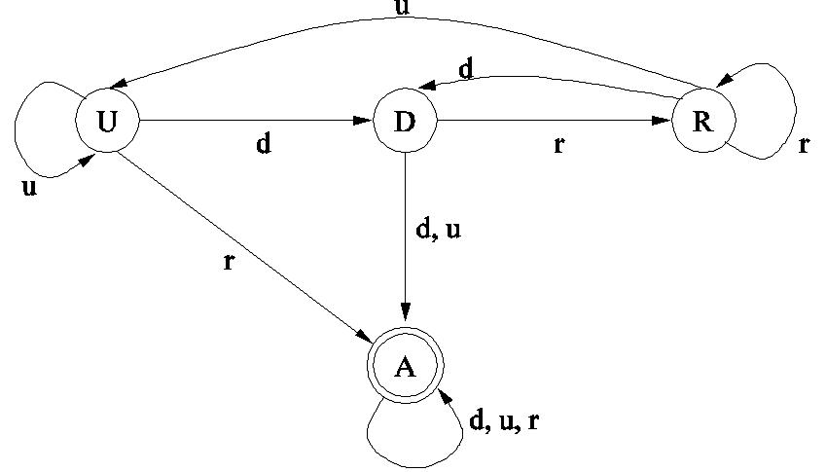
Representing Data Flow Anomaly
Chapter 8: Data Flow Testing
MMH
S.8
The concept of a state-transition diagram is used to model a program variable to identify data flow anomaly. “States” of program variables can be used to identify data flow anomaly.
Components of the state-transition diagrams:
States | U: Undefined D: Defined but not referenced R: Defined and referenced A: Abnormal
Actions | d: define the variable r: reference/read the variable u: undefine the variable

Slide 9
State transition diagram of a program variable
Chapter 8: Data Flow Testing
MMH
S.9
Initially, a variable can remain in an “undefined” (U) state, meaning that just a memory location has been allocated to the variable but no value has yet been assigned (declared).
At a later time, the programmer can perform a computation to define (d) the variable in the form of assigning a value to the variable –this is when the variable moves to a “defined but not referenced” (D) state.
At a later time, the programmer can reference (r), that is, read, the value of the variable, thereby moving the variable to a “defined and referenced” state (R) . The variable remains in the R state as long as the programmer keep referencing the value of the variable.
If the programmer assigns a new value to the variable, the variable moves back to the D state. On the other hand, the programmer can take an action to undefine (u) the variable.

Slide 10
State transition diagram of a program variable
Chapter 8: Data Flow Testing
S.10
MMH
However, the programmer can make mistakes by taking the wrong actions while a variable is in a certain state. For example,
If a variable is in the state U – that is the variable is still undefined – and a programmer reads (r) the variable, then the variable moves to an abnormal (A) state.
Similarly, while a variable is in the state D and programmer undefines (u) the variable or redefines (d) the variable, then the variable moves to the abnormal (A) state.
Once a variable enters the abnormal state (A), it remains in that state irrespective of what action – d, u, r is taken.
The abnormal state of a variable means that a programming anomaly has occurred.

Slide 11
State transition diagram of a program variable
Chapter 8: Data Flow Testing
S.11
MMH
Data flow anomaly can be detected by using the idea of program instrumentation
Program instrumentation: Insert new code to monitor the states of variables
If the state sequence contains dd, ur, or du sequence, a data flow anomaly is said to have occurred.
Question: Does the presence of data flow anomaly always mean that execution of the program will result in a failure?
Answer: Not always…
The presence of a data flow anomaly in a program does not necessarily mean that execution of the program will result in a failure (e.g. dd – define and define again)
A data flow anomaly simply means that the program may fail, and therefore the programmer must investigate the cause of the anomaly.

Slide 12
State transition diagram of a program variable
Chapter 8: Data Flow Testing
S.12
MMH
Scenario 1: A data flow anomaly does not lead to program failure
Let us consider the dd anomaly in Example 1.
If the real intention of the programmer was to perform the second computation and the first computation produces no side effects, then the first computation merely represents a waste of processing power. Thus dd anomaly will not lead to program failure.
Scenario 2: A data flow anomaly leads to a program failure
If a statement is missing in between the two statements in Example 1, then the program can possibly lead to a failure.

Slide 13
State transition diagram of a program variable
Chapter 8: Data Flow Testing
S.13
MMH
While data flow anomalies are dangerous signs, they may or may not lead to defects
A defined, but never used variable may just be extra stuff
Some compilers will assign an initial value of zero or blank to all undefined variable based on the data type
Multiple definitions prior to usage may just be bad and wasteful logic
The programmers must analyze the causes of data flow anomalies and eliminate them.
Investigate the cause of the anomaly
To fix an anomaly, write new code or modify the existing code

Slide 14
Data flow graph
Chapter 8: Data Flow Testing
S.14
MMH
Data-flow testing uses the data flow graph to explore the unreasonable things that can happen to data (i.e., anomalies)
In practice, programmers may not draw data flow graphs by hand. Instead, language translators are modified to produce data flow graphs from program units
A data flow graph is drawn with the objective of identifying data definitions and their uses.
Each occurrence of a data variable is classified as follows:
Definition (d)
Kill (k)
Use (u):
c-use: Used in a calculation
p-use: Used in a predicate

Slide 15
Data flow graph
Chapter 8: Data Flow Testing
S.15
MMH
This occurs when a value is moved into the memory location of the variable (i.e. a variable gets new value)
i = x; /* The variable i gets a new value. */
Kill: This occurs if the value and the location become unbound (release)
Use: This occurs when the value is fetched from the memory location of the variable. There are two forms of uses of a variable –
1. Computation use (c-use)
Example: x = 2*y; /* y has been used to compute value of x */
2. Predicate use (p-use)
Example: if (y > 100) { …} /* y has been used in a condition */

Slide 16
Data flow graph
Chapter 8: Data Flow Testing
S.16
MMH
Data flow testing criteria are based on two fundamental concepts:
Definitions
Uses (both c-uses and p-uses of variables)
Definition C-use P-use
1. read (x, y); x, y
2. z = x + 2; z x
3. if (z < y) z, y
4. w = x + 1; w x
5. else
6. y = y + 1; y++; y+=3; y y
7. z = f1 (x, y) z x,y
8. print (x, y, w, z); x,y,w,z

Slide 17
references
Chapter 8: Data Flow Testing
S.17
Software Testing And Quality Assurance – Theory and Practice - Kshirasagar Naik & Priyadarshi Tripathy
Software Quality Engineering: Testing, Quality Assurance and Quantifiable Improvement - Jeff Tian

